Slide 1
Shall We Dance?
Nina Laurenzo & Amy R. Murrell, Ph.D.
University of North Texas
Notes:
- Goodmorning! My name is Nina Laurenzo, I am an undergraduate at the University of North Texas, and I am here today to talk to you about dance, the obvious role it plays in our everyday lives, and the less obvious role it could play in contextual behavioral science.

Slide 2
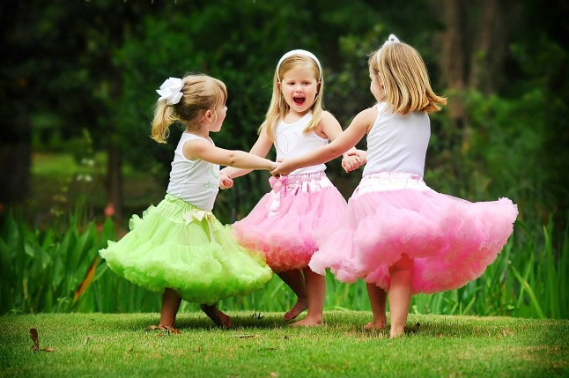
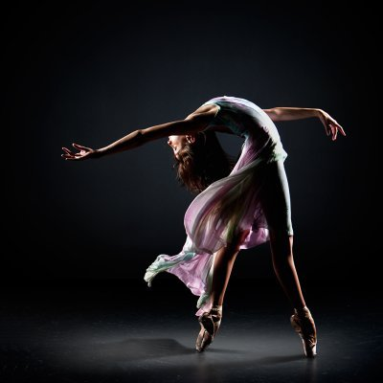
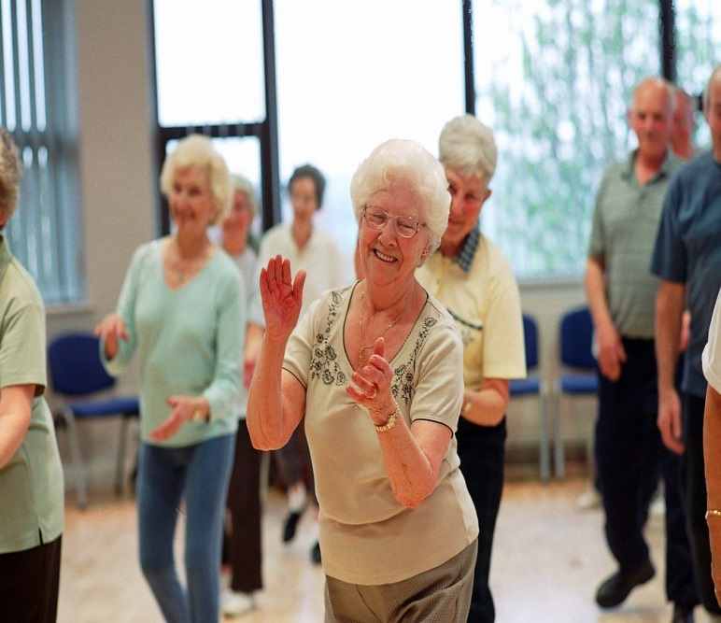
Notes:
- Whether we like it or not, from the moment we begin to move, we are all dancers. Whether for pleasure, exercise, social interaction, or simply something to do – we all have bodies, and (even if just when we were kids) have all felt the bliss that comes from connecting to and using them through dance.

Slide 3
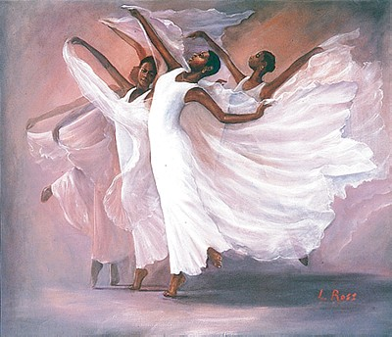
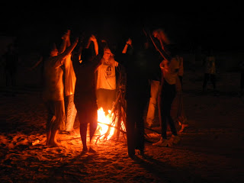
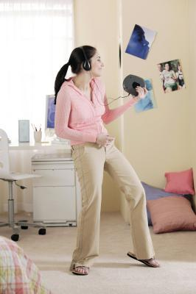
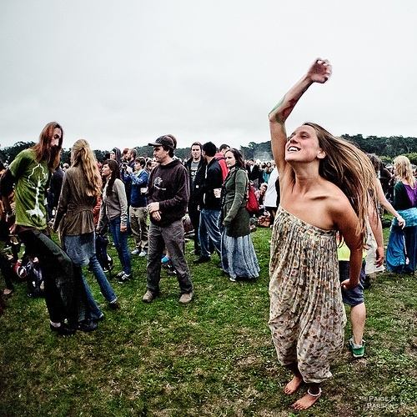
Notes:
Dance is all around us. In your backyard, in our schools, around campfires, at weddings and parties and concerts and proms, and especially in our bedrooms when we think that no one is watching.
It is also a common depiction of joy, camaraderie, and expression in art and literature.

Slide 4
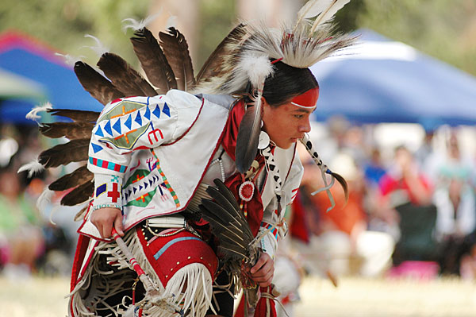
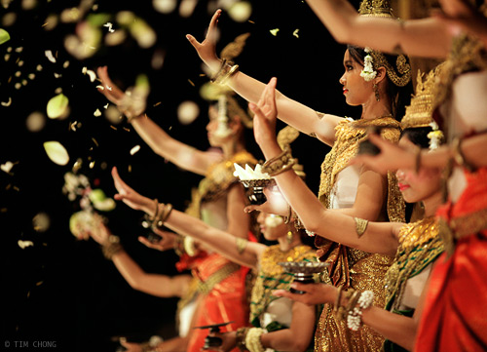
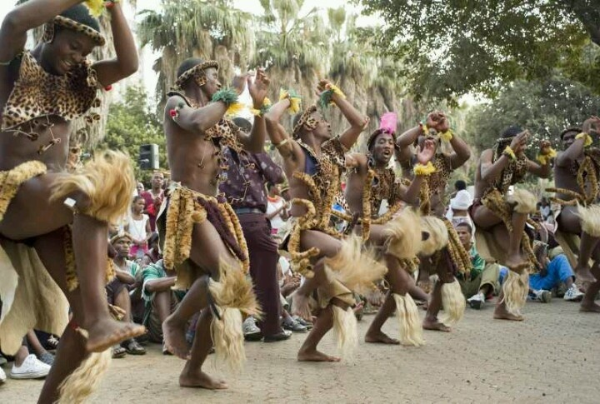
Notes:
- And, In many cultures, dance is viewed as vital to maintaining physical, spiritual, and psychological well-being. It is a valued form of cultural understanding and expression and an integral part of everyday life.

Slide 5
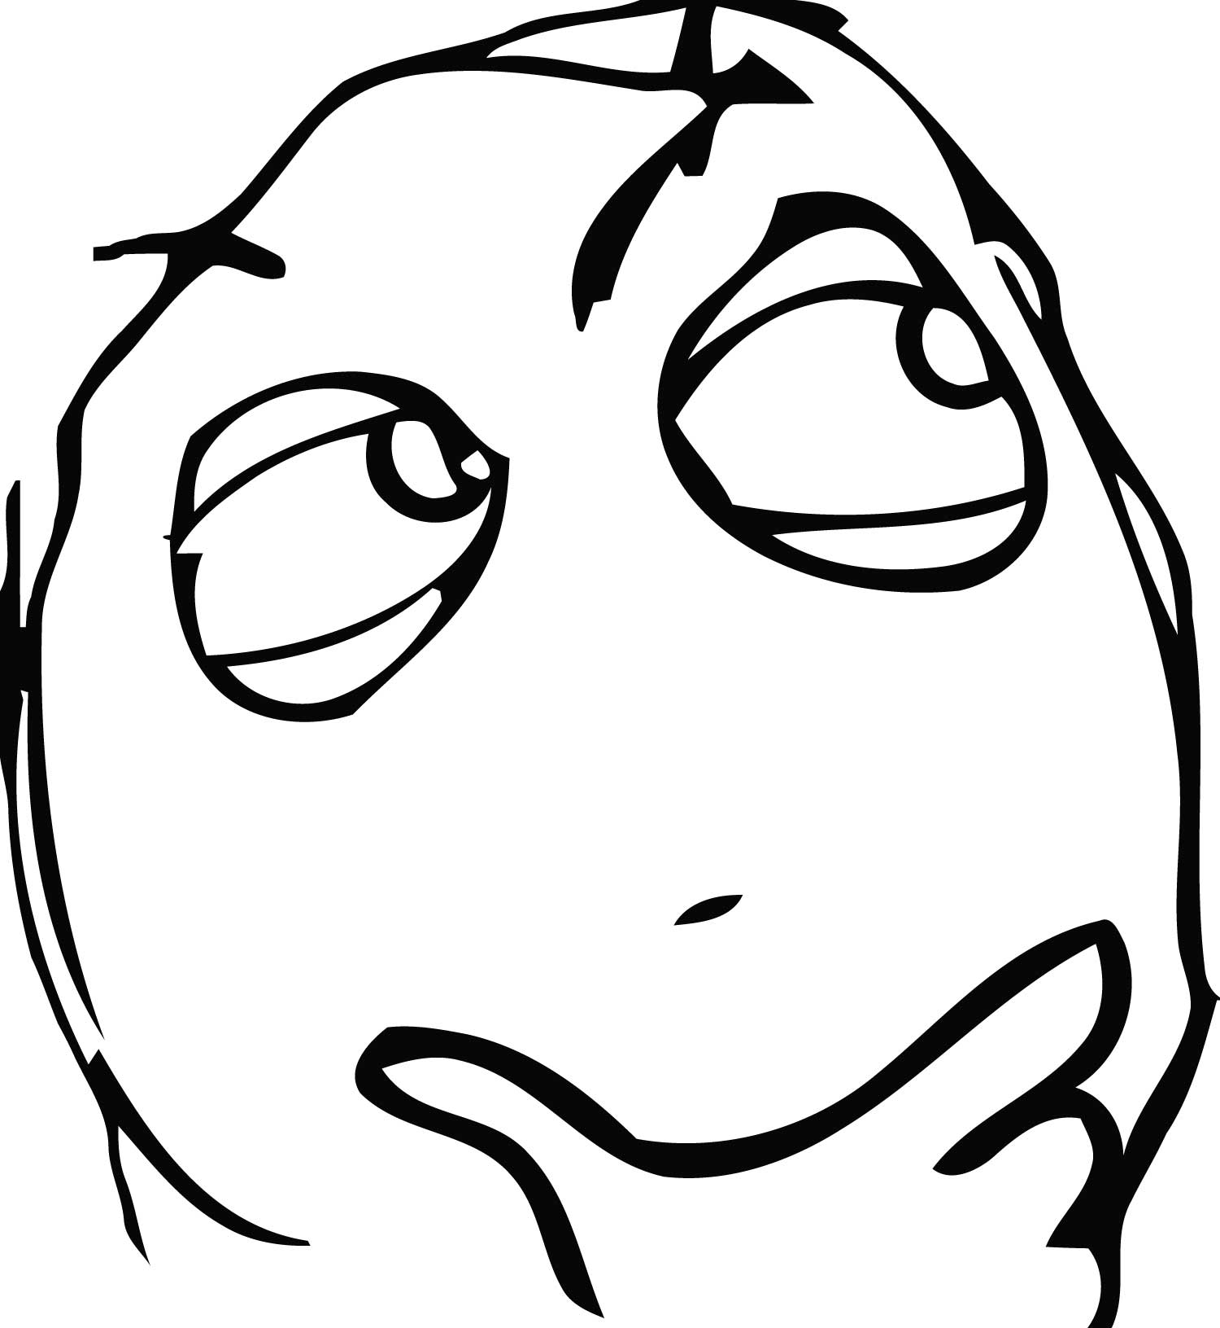
Notes:
- So dance is great, it is all around us, and a majority of us do it regularly. But what does dance have to offer psychology? Can it be beneficial to contextual behavioral science in concrete, measurable ways?

Slide 6
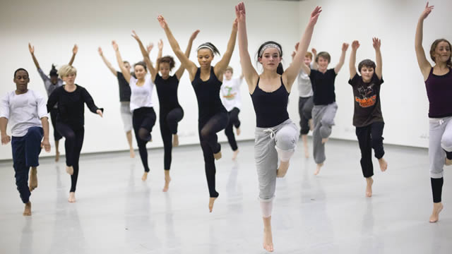
Body image
Self-worth Attractiveness/Strength
Depression
Stress
Anxiety
Psychological Distress
Notes:
Dance has been known to foster a mass of physical benefits, and the literature for psychological benefits is gaining support as well.
In recreational dance interventions with adolescents, researchers have found increased perceptions of attractiveness, self-worth, and strength paired with decreases in psychological distress.

Slide 7
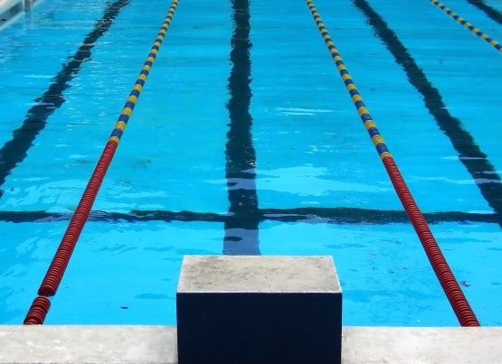
Notes:
- Across several unique studies, these effects were apparent in dance intervention, but not other aerobic exercise groups, showing there may be more to dance than to exercise alone.

Slide 8
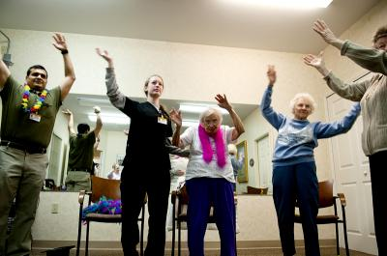
Stress Management and Coping
Reality Orientation
Ability to Stay Bodily Present
Notes:
Stronger still are results from studies involving DMT, which have shown increased stress management and coping in the chronically stressed, and increased reality orientation and present moment contact in traumatized dissociative individuals.

Slide 9
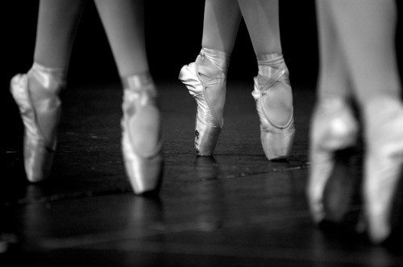
Notes:
- And these are just a handful of the studies that are out there in a quickly growing field of research.
So why should dancing be of interest to you at all? How can we as contextual behavioral scientists use this information in a way that makes sense with the work that we do?
Let’s look at the model for psychological flexibility and compare it to the goals of dancers.

Slide 10
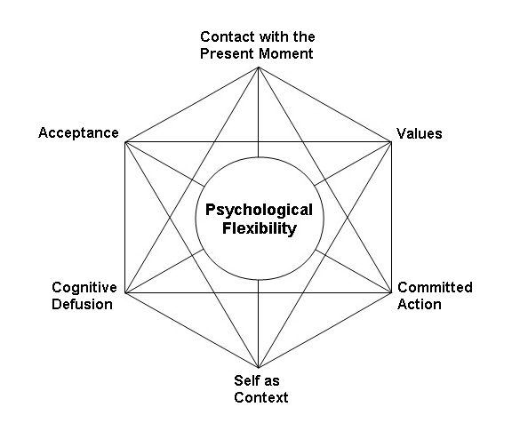
Notes:
- Both dance and the psychological flexibility model are all about understanding and working with things internally and then doing something you care about with them outside of yourself. They revolve around the relationship between internal insights and external action in a valued direction

Slide 11
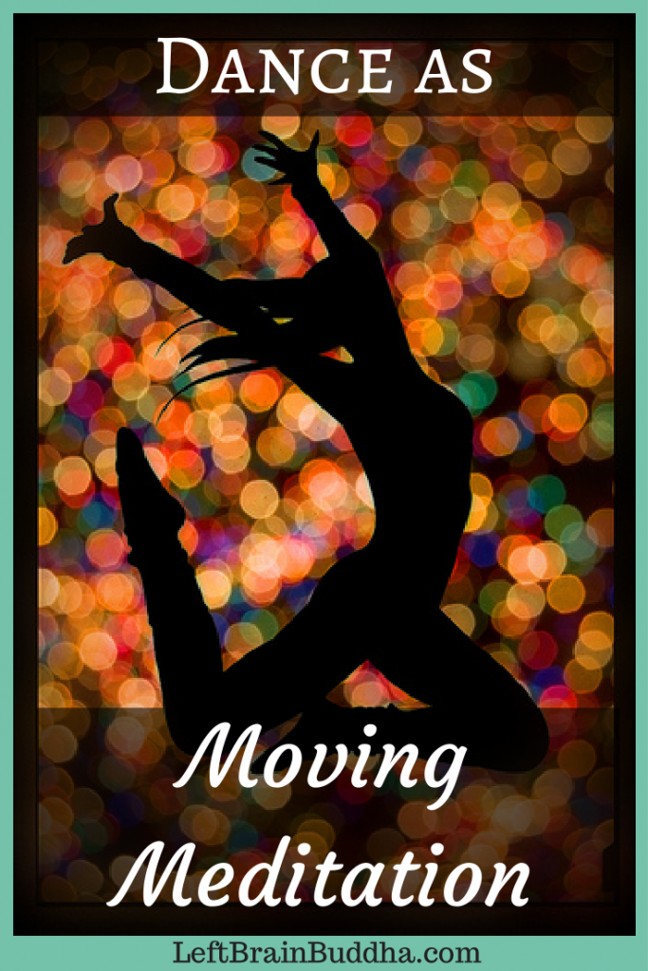
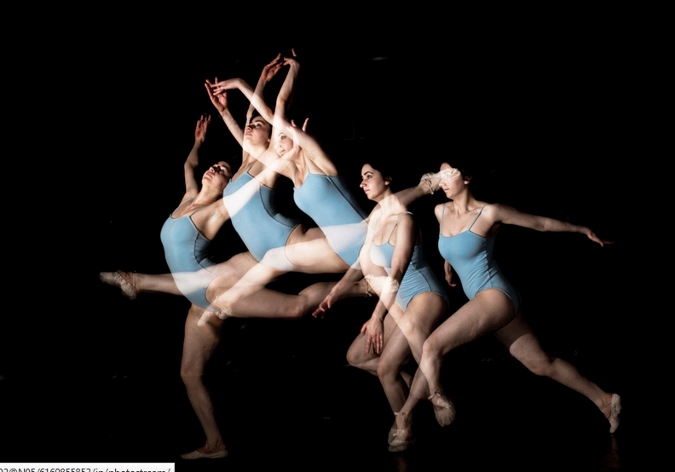
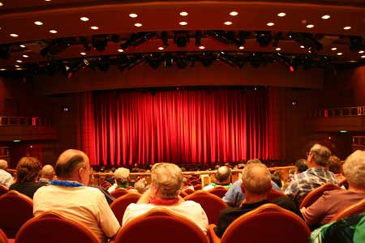
Notes:
Even at first glance, dancers may be some of the most flexible (physically and psychologically speaking) people we know.
In the service of expression, they must contact their bodies and minds in the present moment, accept what is happening inside of them, defuse from any fears of “not performing well” or “not looking right,” and committingly move in a way that they care about in that moment.
- And I have seen this process in action

Slide 13
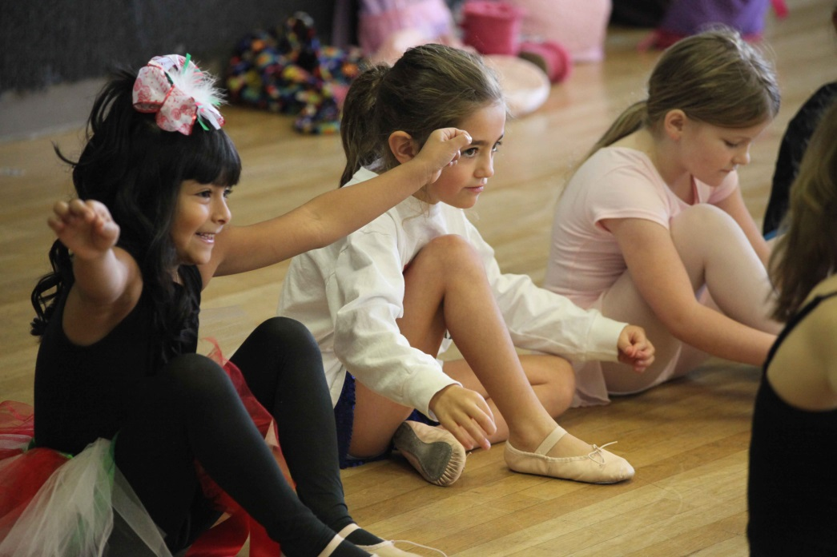
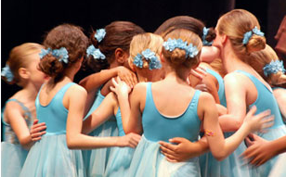
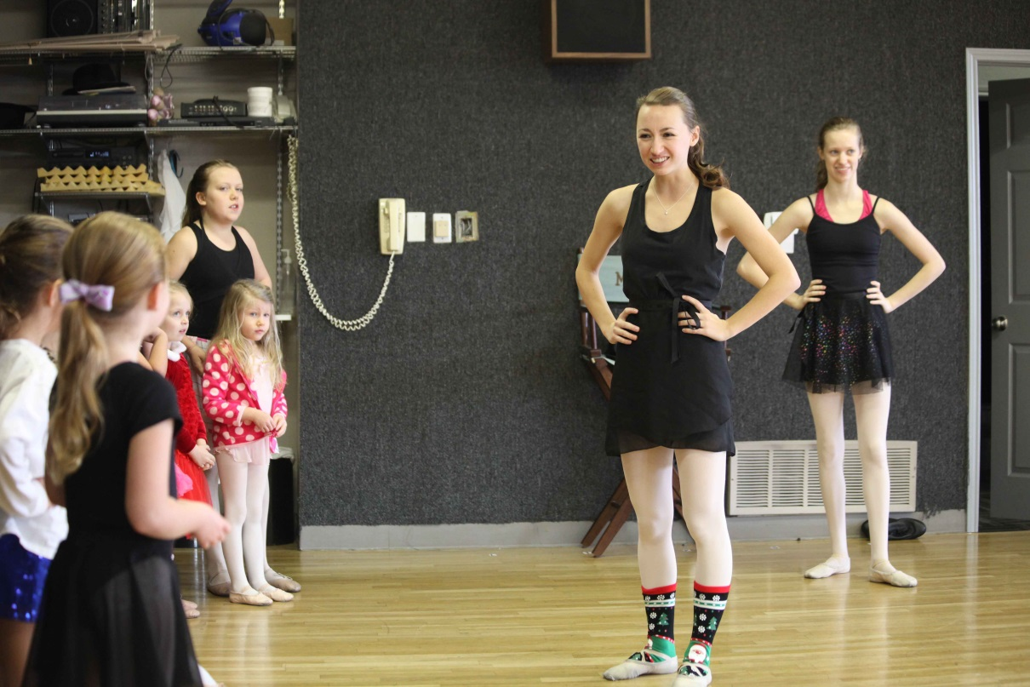
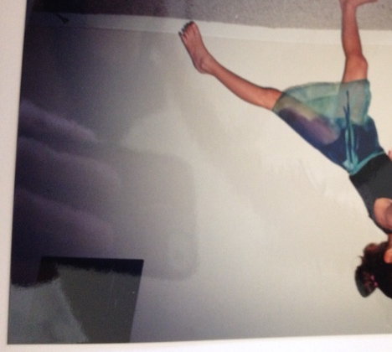
Notes:
I can honestly attribute much of the way I approach my world and do the things that I care about to how much I danced when I was young.
That’s me, in the bottom corner at about the time I learned what dance could do for my mental well-being, and these are some of the kids that I teach.

Slide 14
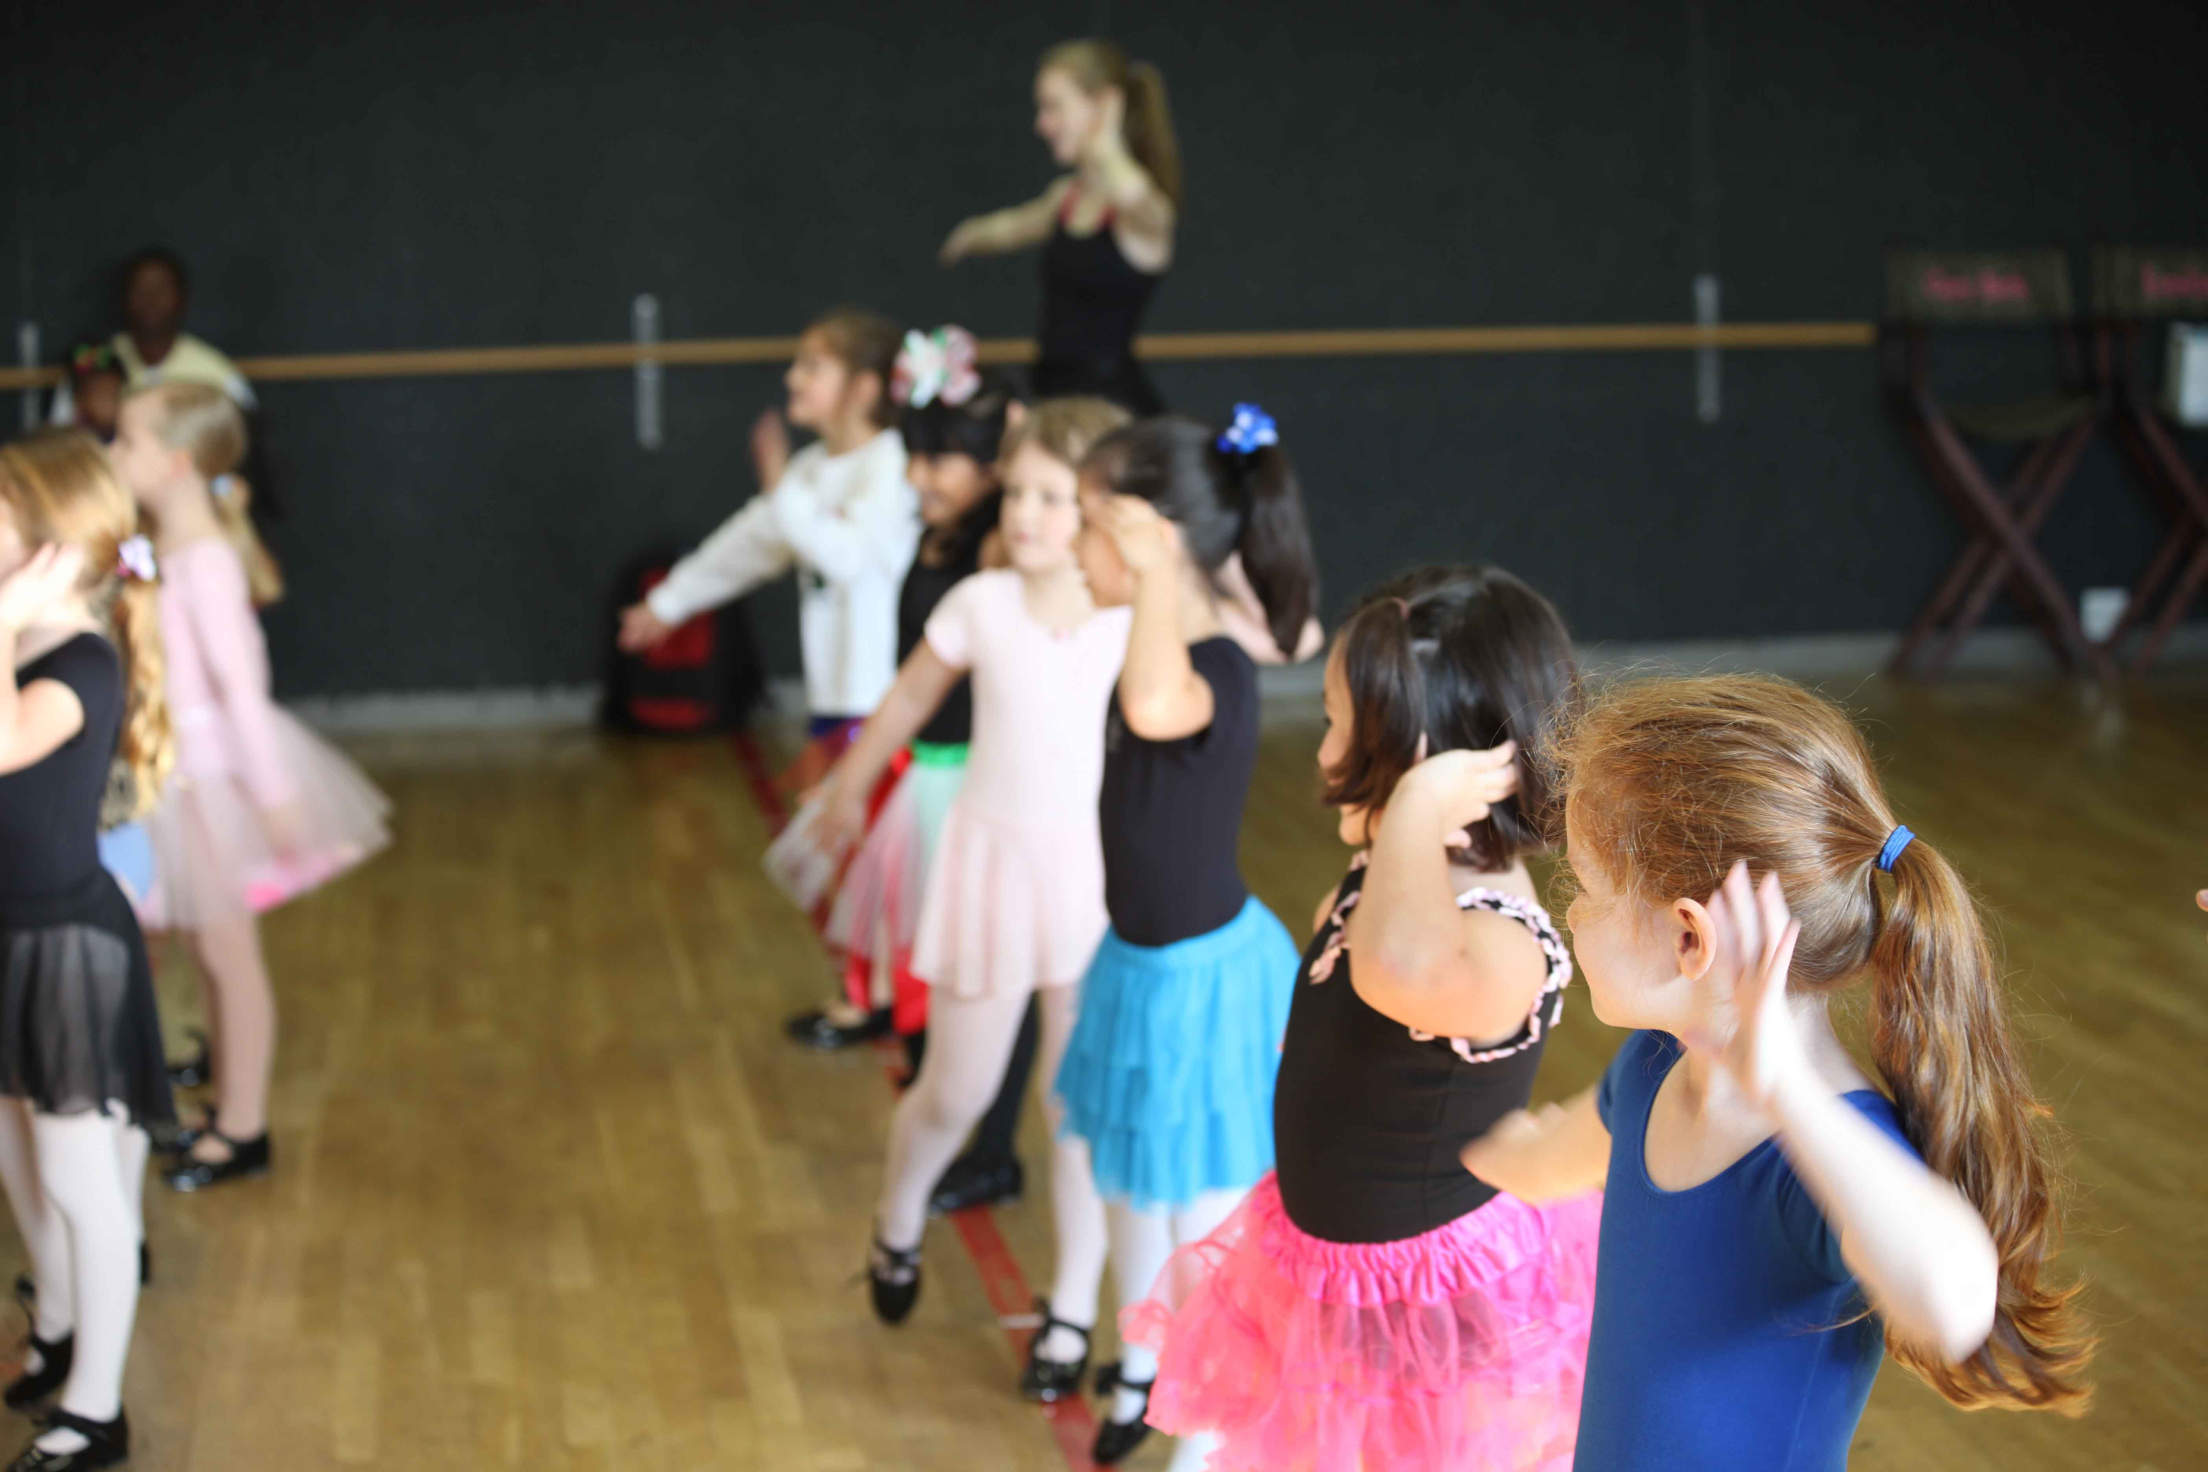
Notes:
I work with children in a dance studio several days a week, and I SEE these positive outcomes happening within them - through dance.
This sparked a curiosity in me I had to explore further. Currently, I am working on my undergraduate thesis on the psychological flexibility of recreational dancers between the ages of 12 and 18.

Slide 15
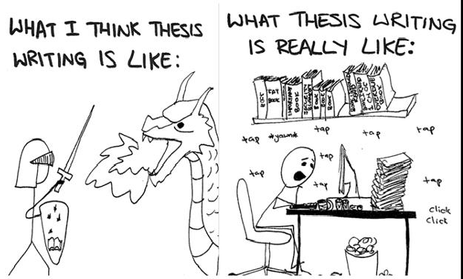
Notes:
- So far, I have collected data from 19 young dancers, and am seeing a trend toward higher flexibility as measured by the avoidance/fusion questionnaire, the willingness and action measure, and the child/adolescent mindfulness measure.

Slide 16
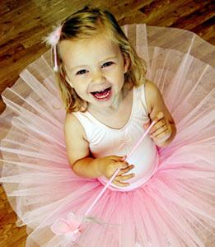
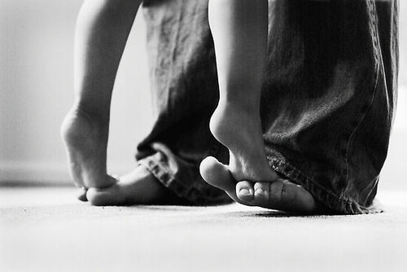
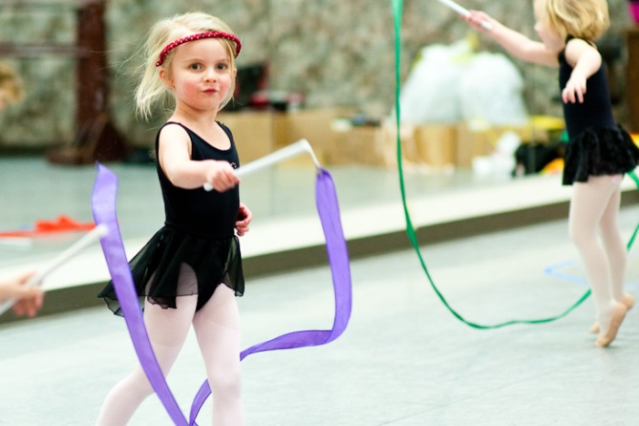
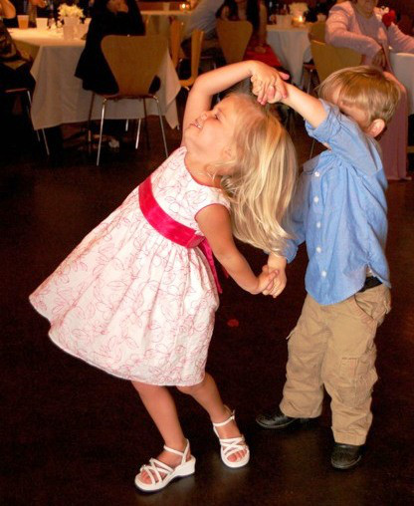
Notes:
- I think that incorporating dance is important in work with all ages, but I want you to consider this specifically with kids. Children love to dance. When have you seen children more in contact with their present moment then when they are learning and using their bodies? Or more defused from their problems then when they play and spin and jump? More committed in action than when they are expressing themselves?

Slide 17
Notes:
Maybe dancing can be used as a tool to foster psychological flexibility. Or, if anything, for helping our kids and ourselves express from a place of awareness of our own bodies and minds.

Slide 18
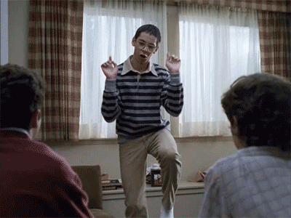
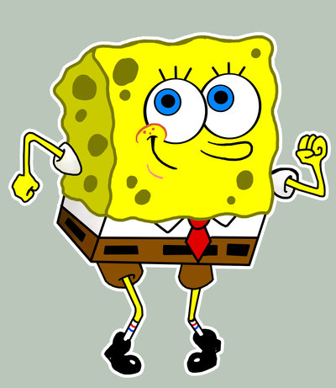
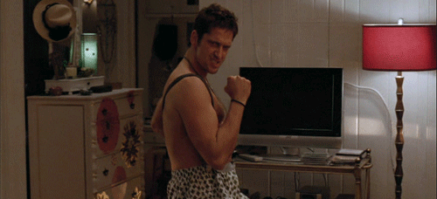
Notes:
We know, not just as scientists and practioners of psychology but as human beings with bodies that moving them feels good. And there is a growing field of research and researchers that tells us it does us more good than we know. And you don’t even have to be “good” at it.

Slide 19
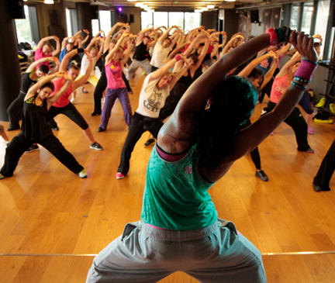
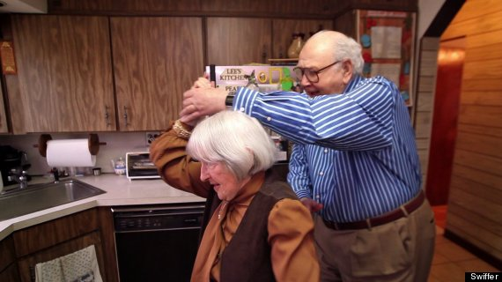
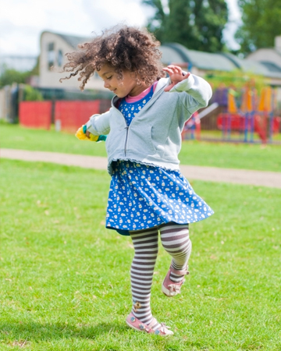
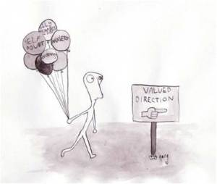
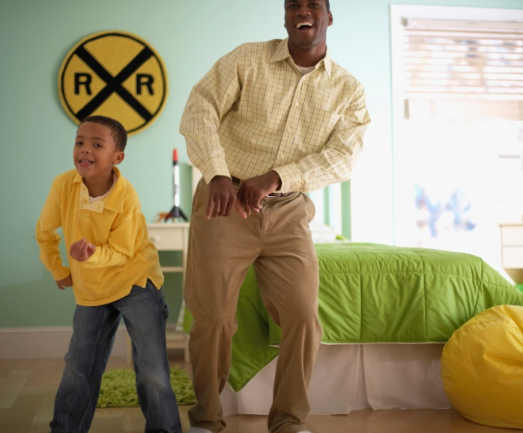
Notes:
- What do we have to lose by incorporating a little dance into our lives?
- This movement, this thing we are all built for can truly be a powerful thing. And maybe, with a little dancing, we can reign in the power of expression and move a little more limberly down our own valued paths.

Slide 20
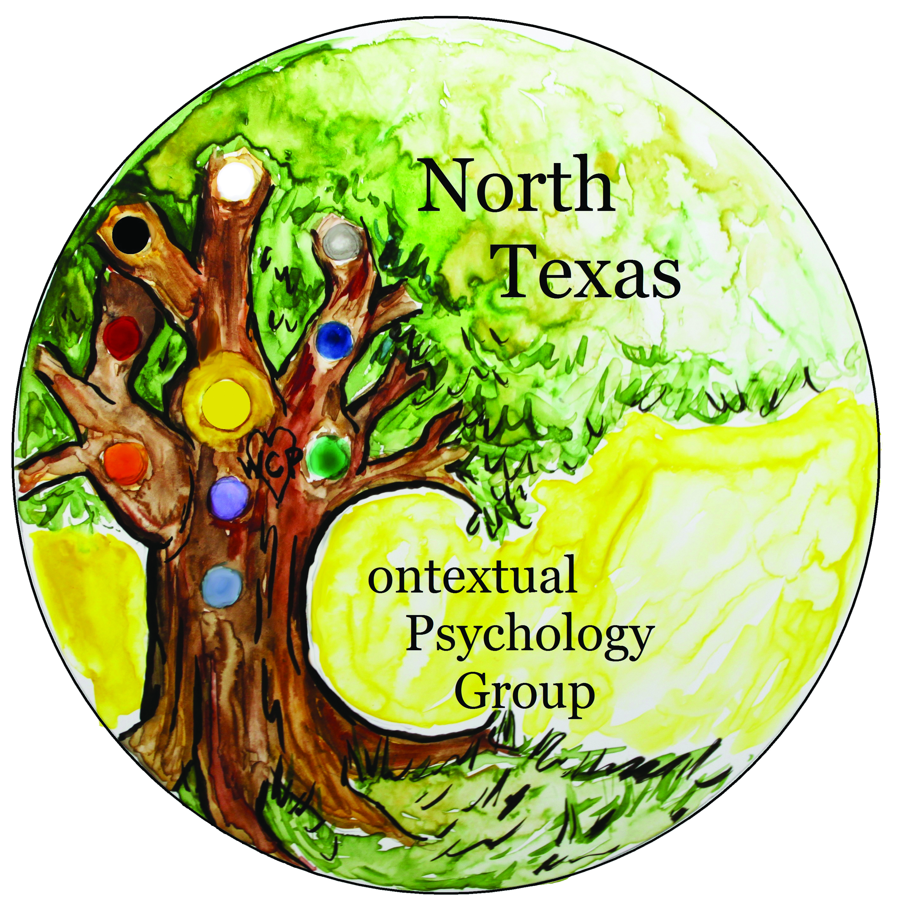
Thank You!
Notes:
Thank you

